Slide 1
Clustering & PCA Assignment
Neelima Bhavanasi
24th Feb 2020

Slide 2
Problem Statement
To find the underdeveloped countries based on socio-economic and health factors so that Help International Company can rightly focus on the countries which require help

Slide 3
Analysis Approach
Data Prep: The data is cleaned and prepared for the PCA analysis by removing the missing values, outliers and by standardising the data
Applying PCA: PCA is applied on the data and chose the principal components which can explain about 95% variance of the data. In this case 4 Principal Components(PC’s) are chosen
K-Means Clustering: The number of clusters K is chosen as 3 based on the elbow curve and Silhouette method. With K as 3, K-Means clustering is applied on the data. Countries have been segregated based on those three clusters.(Developed, Developing and Under Developing countries based on GDP, income and child-mortality features)
Hierarchical Clustering: Hierarchical clustering is done both by single linkage and complete linkage. Clusters are more meaningful in complete linkage when compared to the single linkage. So, by complete linkage method 4 clusters can explain the segmentation of countries based on the gdp, income and child mortality features

Slide 4
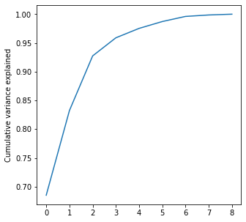
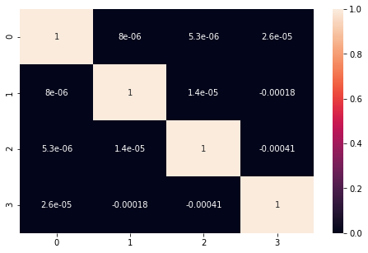
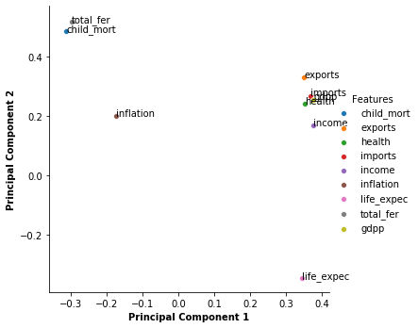
Principal Component analysis (PCA)
From the heat map we can observe there is no correlation between the variables.
PC1,PC2,PC3 and PC4 explain about 95% of variance. So, 4 PC components are chosen.
Life expectancy, income, gdpp, imports, exports and health are very well explained by PC1.
Child mortality and total fertility are well explained by PC2.
Inflation is neither explained by PC1 nor with PC2

Slide 5
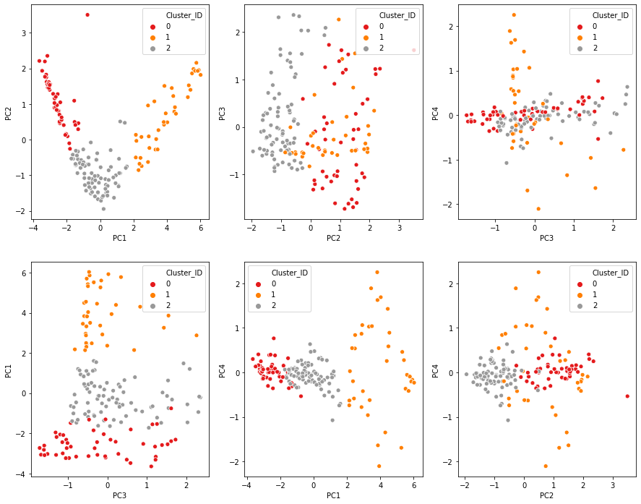
Principal Component Analysis and K-Means Clustering
Clustering analysis on the principal components
From the scatter plot of PC1 and PC2 (left top most, highlighted in red) the segmentation into three clusters are very clear.

Slide 6
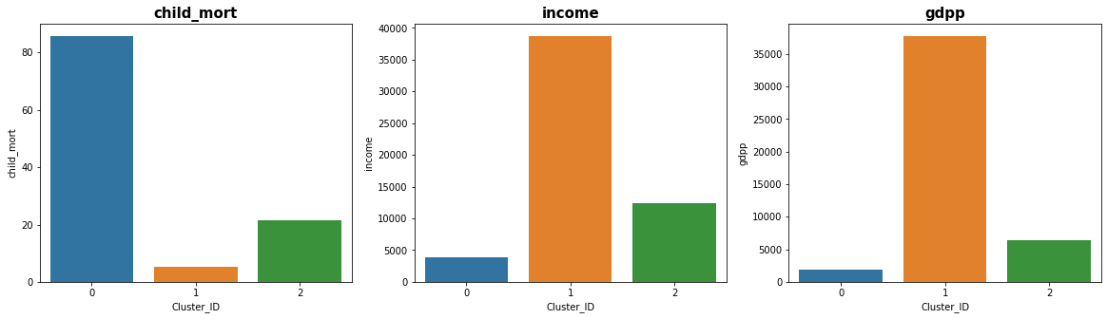
Principal Component Analysis and K-Means Clustering
After doing the K means clustering on the PC data we arrived at 3 clusters (Cluster_ID 0, 1, 2) as shown above in the picture
Cluster 0 : This cluster indicates Under developed countries as it has high child mortality, less income and gdpp
Cluster 1: This cluster indicates Developed countries as it has less child mortality, high income and high gdpp
Cluster 2: This cluster indicates Developing countries as it is between developed and under developed countries with medium child mortality , income and gdpp

Slide 7
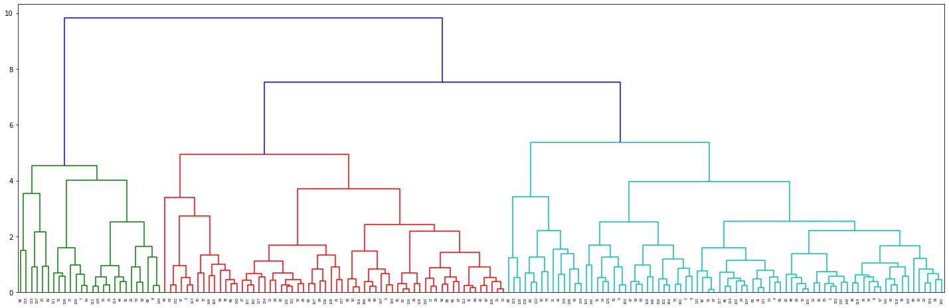
Principal Component Analysis and Hierarchical Clustering
Visualisation of Dendrogram of Hierarchical clustering using complete linkage

Slide 8
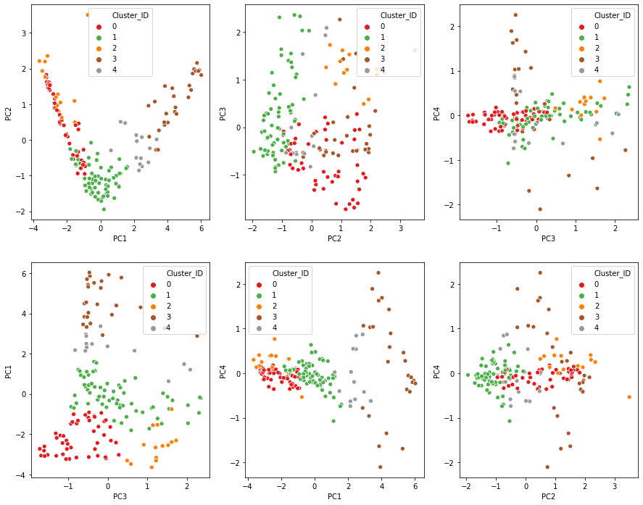
Principal Component Analysis and Hierarchical Clustering
Visualisation of clusters on the PC components
Though we see the overlapping of the clusters in hierarchical clustering the segmentation still explains the segregation of countries based on the features gdpp, income and child mortality

Slide 9
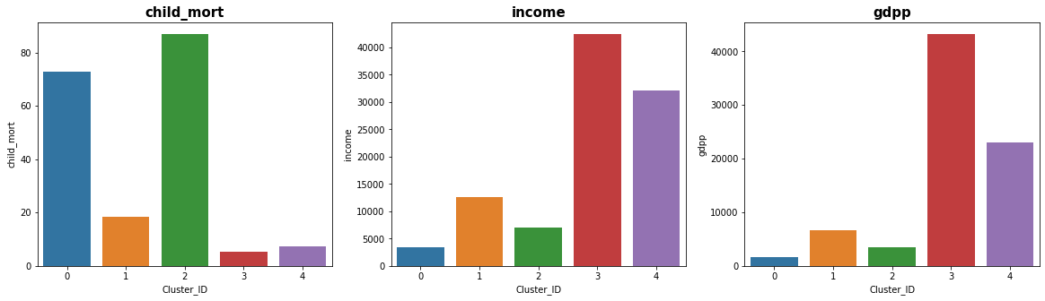
Principal Component Analysis and Hierarchical Clustering
Visualisation of clusters on the original dataset for features child-mort, income and gdpp
Cluster 0 and 2: Indicates Under developed country with high child mort and less income and gdpp
Cluster 1 and 4 : Indicates developing countries based on medium child mortality , income and gdpp
Cluster 2: Indicates developed countries with less child mortality and high income and gdp

Slide 10
Final list of countries
Burundi
Central African Republic
Congo
Liberia
Malawi
Mozambique
Niger
Sierra Leone
Madagascar
Eritrea
Are the first 10 countries which require financial aid.

